Slide 1
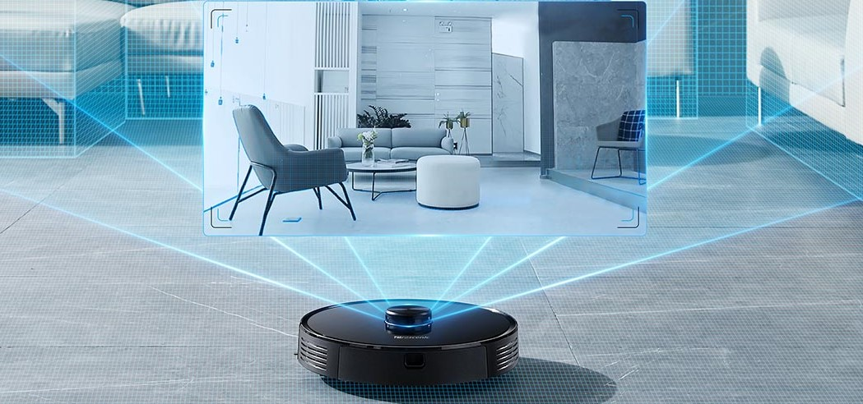
Presentation on CSE561 Project
COMPARISION BETWEEN PERFORMANCE OF DIFFERENT KINDS OF BATTERIES USED IN ROBOTIC VACUUM CLEANERS
BY: SWATI MAHAPATRA
VIRAJ SONAJE

Slide 2
MOTIVATION
An autonomous robotic vacuum cleaner offers floor cleaning system.
An automated vacuum cleaner must have:
Good battery performance - how long you can use it
Smart decision-making capability - how it cleans the surface without disturbing the surrounding objects or humans.
Different environments need different types of Robovacs depending on the amount of work to be done thus maintaining battery levels while operating.
This is our motivation for this project.

Slide 3
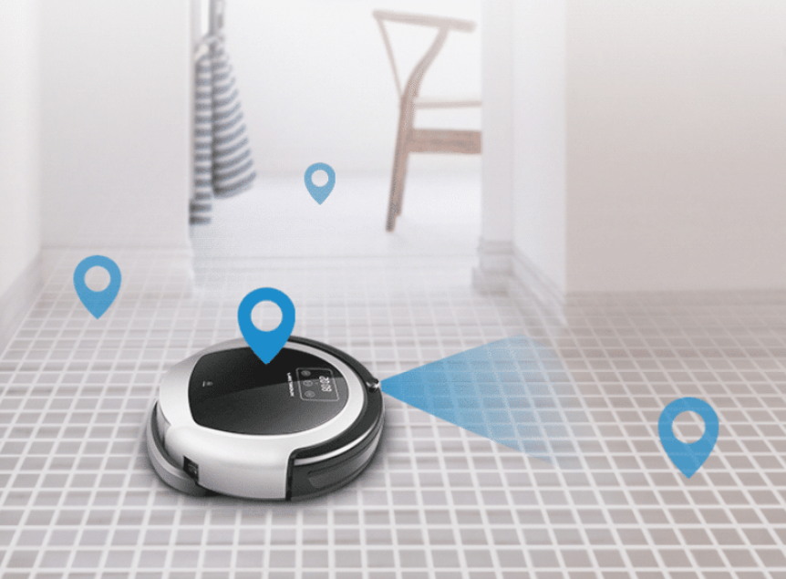
OBJECTIVE
To design models of Robovacs with different kinds of batteries.
Do case studies : Comparing the performance of different battery types in Robotic vacuum cleaners when exposed to various constraints and environments.

Slide 4
SYSTEM DESCRIPTION
Power Supply (Battery)
Multiple batteries as an energy source (considered as continuous energy supply)
Monitor its usage for every type of environment
Specification of the actuators and sensors
Time for which it is being used.
Motors
Used to move the wheels of the bot.
To operate the fan at the intake port.

Slide 5
Sensors
Consists of :
(LiDAR) sensor - used to scan the room and create a virtual map of the space around it.
Infrared (IR) sensor - to detect obstacles and dust particles during the actual operation of the bot.
Electronic control unit
Responsible to take in all the inputs from the sensors and guide the actuators of the system.

Slide 6
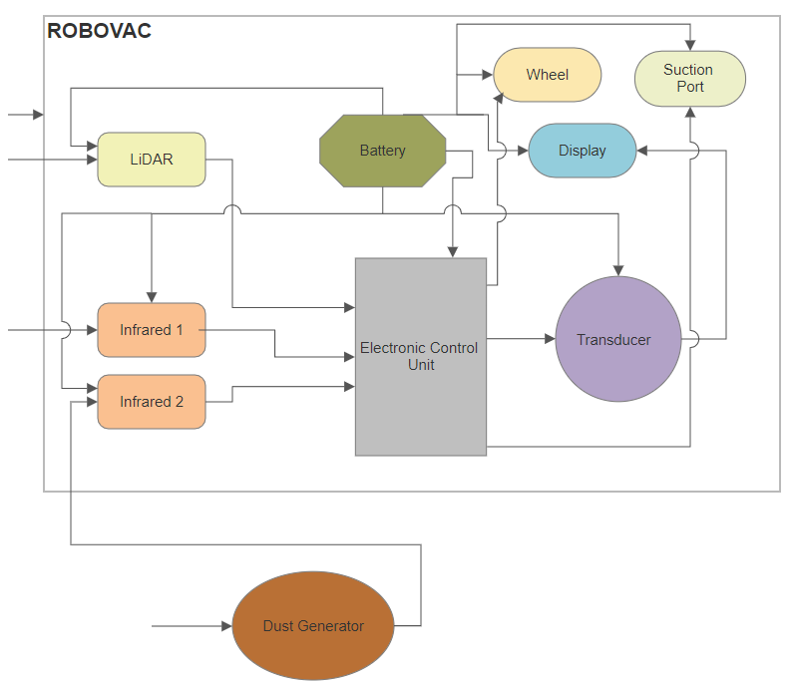
Block Diagram

Slide 7
Pseudocode
IF dirt is present
then
clean the place
ELSE IF obstacle is present
then
turn in a direction according to the live sensing data
ELSE
move forward

